Slide 1

DEVELOPING A DEEP LEARNING FRAMEWORK FOR GLAUCOMA DETECTION
Guided by
Dr. P. Malin Bruntha
Assistant Professor
BY,
AISHWARYA M (URK20EC1012)
AALIN JEFFINA S(URK20EC1024)
ESTHER V(URK20EC1022)
ASSUMTHA SONEL F(URK20EC1105)

Slide 2
IN TWO OR THREE COLUMNS
TABLE OF CONTENTS
ABSTRACT
OBJECTIVE
REVIEW OF LITERATURE
DATASET
SOFTWARE USED
FLOWCHART
RESULT AND CONCLUSION
Yellow
Is the color of gold, butter and ripe lemons. In the spectrum of visible light, yellow is found between green and orange.
Blue
Is the colour of the clear sky and the deep sea. It is located between violet and green on the optical spectrum.
Red
Is the color of blood, and because of this it has historically been associated with sacrifice, danger and courage.

Slide 3
IN TWO OR THREE COLUMNS
ABSTRACT
Early diagnosis and treatment are critical for managing glaucoma and preventing further vision loss.
Efficient detection of glaucoma from fundus images remains crucial and a challenging task in nature with varying contrast and boundaries.
As a result, there is a chance that expert systems will misclassify the data. As a way to reduce the misclassification rate, a methodology wherein a deep learning approach integrated with an evolutionary algorithm is proposed.
Transfer learning is a machine learning technique that allows a model trained on one task to be applied to a different but related task without the need for significant additional training.
In transfer learning we worked with models like ResNet152, VGG16, VGG19, MobileNet V2, Inception V3, DenseNet121 , MobileNet , ResNet50 V2, Inception_ResNet , Xception using Keras. And found that Xception model is giving high accuracy comparatively.
The efficiency of this fully automated system is evaluated on public retinal fundus image database LAG.
Yellow
Is the color of gold, butter and ripe lemons. In the spectrum of visible light, yellow is found between green and orange.
Blue
Is the colour of the clear sky and the deep sea. It is located between violet and green on the optical spectrum.
Red
Is the color of blood, and because of this it has historically been associated with sacrifice, danger and courage.

Slide 4
IN TWO OR THREE COLUMNS
OBJECTIVE
Yellow
Is the color of gold, butter and ripe lemons. In the spectrum of visible light, yellow is found between green and orange.
Blue
Is the colour of the clear sky and the deep sea. It is located between violet and green on the optical spectrum.
Red
Is the color of blood, and because of this it has historically been associated with sacrifice, danger and courage.
To develop a deep learning model that can accurately detect the presence of glaucoma in retinal fundus images.

Slide 5
IN TWO OR THREE COLUMNS
PROBLEM STATEMENT
Yellow
Is the color of gold, butter and ripe lemons. In the spectrum of visible light, yellow is found between green and orange.
Blue
Is the colour of the clear sky and the deep sea. It is located between violet and green on the optical spectrum.
Red
Is the color of blood, and because of this it has historically been associated with sacrifice, danger and courage.
Glaucoma is a serious eye condition that can lead to vision loss if not diagnosed early.
Early detection of glaucoma using deep learning technique with high accuracy and high sensitivity is the need of the hour.

Slide 6
IN TWO OR THREE COLUMNS
REVIEW OF LITERATURE
TITLE | AUTHOR, JOURNEL, YEAR | DATA SET | ALGORITHM USED | REMARKS
Deep learning-based classification network for glaucoma in retinal images [1] | AUTHOR : Mamta Juneja, Sarthak Thakur JOURNEL NAME : Computers and Electrical Engineering YEAR : 2022 | ORIGA, DRISHTI-GS, RIM-ONE-r3 | CoG-NET(A modified version of xception network) | A deep learning-based classification network for glaucoma in retinal images, achieving 93.5% accuracy, 0.95 sensitivity, 0.99 specificity, and 0.99 AUROC
A new convolution neural network model ‘‘KR-NET’’ for retinal fundus glaucoma classification [2] | AUTHOR: Kamesh Sonti, Ravindra Dhuli JOURNEL NAME : Optik International journel for light and electron optics YEAR : 2023 | ACRIMA, RIM-ONE and Drishti-GS1 datasets Fundus image | KR-NET algorithm | It is concluded that our proposed model effectively classifies healthy and glaucoma images compared to other state-of-the-art approaches.
Yellow
Is the color of gold, butter and ripe lemons. In the spectrum of visible light, yellow is found between green and orange.
Blue
Is the colour of the clear sky and the deep sea. It is located between violet and green on the optical spectrum.
Red
Is the color of blood, and because of this it has historically been associated with sacrifice, danger and courage.

Slide 7
IN TWO OR THREE COLUMNS
TITLE | AUTHOR, JOURNEL, YEAR | DATA SET | ALGORITHM USED | REMARKS
Combination of clinical and multiresolution features for glaucoma detection and its classification using fundus images [3] | AUTHOR : T.R. Kausu et al. JOURNEL NAME : Biocybernetics and Biomedical Engineering YEAR : 2018 | ORIGA, DRISHTI-GS, RIM-ONE | Fuzzy C-Means clustering, Otsu’s thresholding, multilayer perceptron | A novel method for glaucoma identification based on CDR and wavelet features
Glaucoma classification based on intra-class and extra-class discriminative correlation and consensus ensemble classifier [4] | AUTHOR: Balasubramanian Kishore and N.P. Ananthamoorthys JOURNEL NAME : Genomics YEAR : 2020 | HRF and DRIVE | IEDCA and CCM | Proposed a novel fused feature extraction technique and ensemble classifier fusion for glaucoma diagnosis
Yellow
Is the color of gold, butter and ripe lemons. In the spectrum of visible light, yellow is found between green and orange.
Blue
Is the colour of the clear sky and the deep sea. It is located between violet and green on the optical spectrum.
Red
Is the color of blood, and because of this it has historically been associated with sacrifice, danger and courage.

Slide 8
IN TWO OR THREE COLUMNS
TITLE | AUTHOR, JOURNEL, YEAR | DATA SET | ALGORITHM USED | REMARKS
Glaucoma multi-classification using the novel syndrome mechanism-based dual-channel network [5] | AUTHOR: Lingling Fang and Huan Qiao JOURNEL NAME : Biomedical Signal Processing and Control YEAR : 2023 | Clinical dataset of Dalian NO.3 People’s Hospital and public Drishti-GS1 dataset | Glaucoma Syndrome Mechanism-based Dual-Channel network (GSM-DCN) | A multi-classification method for glaucoma diagnosis based on clinical features and deep learning
Automated glaucoma assessment from color fundus images using structural and texture features [6] | AUTHOR : Sharanagouda Nawaldgi and Lalitha Y S JOURNEL NAME : Biomedical Signal Processing and Control YEAR : 2022 | Drishti-GS1, ACRIMA, RIM-ONE-r3, ORIGA | Linear Discriminant Analysis, Random Forest, Support Vector Machine, Naïve Bayesian | The paper proposes a novel method for automated glaucoma assessment from color fundus images using structural and texture features. The results obtained by the proposed work yield an overall efficiency of over 89%.
Yellow
Is the color of gold, butter and ripe lemons. In the spectrum of visible light, yellow is found between green and orange.
Blue
Is the colour of the clear sky and the deep sea. It is located between violet and green on the optical spectrum.
Red
Is the color of blood, and because of this it has historically been associated with sacrifice, danger and courage.

Slide 9
IN TWO OR THREE COLUMNS
TITLE | AUTHOR, JOURNEL, YEAR | DATA SET | ALGORITHM USED | REMARKS
Efficient feature selection based novel clinical decision support system for glaucoma prediction from retinal fundus images [7] | AUTHOR : Law Kumar Singh et al. JOURNEL NAME : Medical Engineering and Physics YEAR : 2024 | Public benchmark datasets and private dataset | Gravitational search optimization algorithm (GSOA) for feature selection and six machine learning models for classification | The paper proposes a novel clinical decision support system for glaucoma prediction from retinal fundus images. The paper claims that the proposed method achieved 95.36 % accuracy and can help doctors in early diagnosis and monitoring of glaucoma.
TRk-CNN - Transferable Ranking-CNN for image classification of glaucoma, glaucoma suspect, and normal eyes [8] | AUTHOR : Tae Joon Jun et al. JOURNEL NAME : Expert Systems With Applications YEAR : 2021 | Glaucoma image dataset from Korea University Medical Center | TRk-CNN (Transferable Ranking Convolutional Neural Network) | A novel method for classifying images with ordinal classes and inter-class relationships, applied to glaucoma fundus images
Yellow
Is the color of gold, butter and ripe lemons. In the spectrum of visible light, yellow is found between green and orange.
Blue
Is the colour of the clear sky and the deep sea. It is located between violet and green on the optical spectrum.
Red
Is the color of blood, and because of this it has historically been associated with sacrifice, danger and courage.

Slide 10
IN TWO OR THREE COLUMNS
TITLE | AUTHOR, JOURNEL, YEAR | DATA SET | ALGORITHM USED | REMARKS
Improved swarm optimization of deep features for glaucoma classification using SEGSO and VGGNet [9] | AUTHOR : Kishore Balasubramanian, K. Ramya , K. Gayathri Devi JOURNEL NAME : Biomedical Signal Processing and Control YEAR : 2022 | Drishti-GS1, ACRIMA,ORIGA, LAG | SEGSO and VGGNet | The proposed hybrid approach performed better in terms of both complexity reduction and classification accuracy, thereby reducing computational time and the consumption of resources
Yellow
Is the color of gold, butter and ripe lemons. In the spectrum of visible light, yellow is found between green and orange.
Blue
Is the colour of the clear sky and the deep sea. It is located between violet and green on the optical spectrum.
Red
Is the color of blood, and because of this it has historically been associated with sacrifice, danger and courage.

Slide 11
IN TWO OR THREE COLUMNS
DATASET
LAG stands for Large-scale Attention-based Glaucoma Dataset.
The LAG dataset is a collection of fundus images for glaucoma detection and analysis.
The LAG dataset can be used for image classification, anomaly detection, and semantic segmentation.
It contains 4854 images. There is train and test folder in the LAG dataset. Train folder consists of Normal 2514 and Glaucoma 1369. Test folder consists of Normal 629 and Glaucoma 342.
Each images are in the size of 500 x 500
Yellow
Is the color of gold, butter and ripe lemons. In the spectrum of visible light, yellow is found between green and orange.
Blue
Is the colour of the clear sky and the deep sea. It is located between violet and green on the optical spectrum.
Red
Is the color of blood, and because of this it has historically been associated with sacrifice, danger and courage.

Slide 12

IN TWO OR THREE COLUMNS
SOFTWARE USED
Jupyter Notebook
Yellow
Is the color of gold, butter and ripe lemons. In the spectrum of visible light, yellow is found between green and orange.
Blue
Is the colour of the clear sky and the deep sea. It is located between violet and green on the optical spectrum.
Red
Is the color of blood, and because of this it has historically been associated with sacrifice, danger and courage.

Slide 13
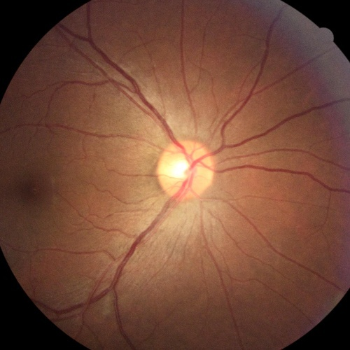
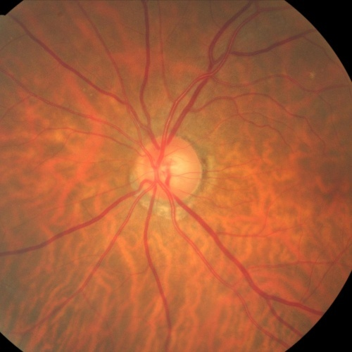
BLOCK DIAGRAM
LAG Dataset
Input
Preprocessing
Classification Model
Normal
Glaucoma

Slide 14
Preprocessing
Rescaling: The Pixel values are rescaled to ensure they fall within the optimal range for neural networks.
Data Augmentation
Rescale,
Shearing,
Zooming,
Horizontal flip

Slide 15
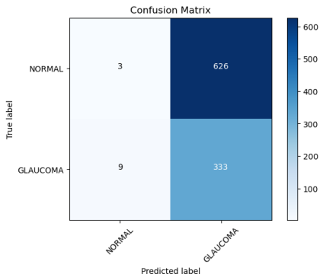
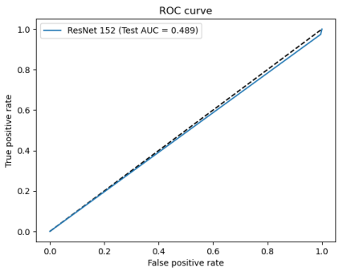
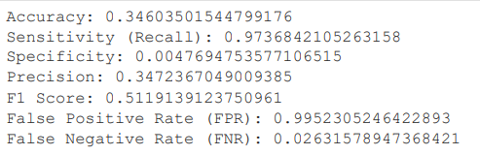
IN TWO OR THREE COLUMNS
RESULT
ResNet 152
Yellow
Is the color of gold, butter and ripe lemons. In the spectrum of visible light, yellow is found between green and orange.
Blue
Is the colour of the clear sky and the deep sea. It is located between violet and green on the optical spectrum.
Red
Is the color of blood, and because of this it has historically been associated with sacrifice, danger and courage.

Slide 16
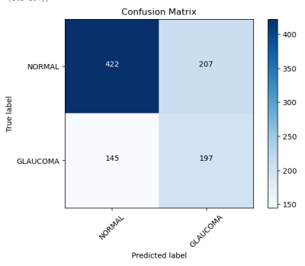
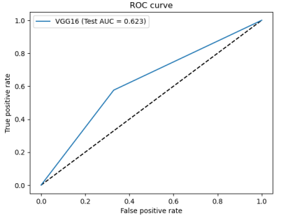
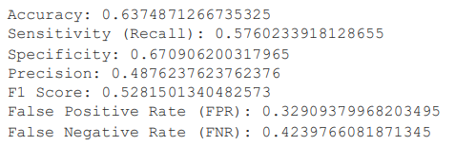
IN TWO OR THREE COLUMNS
VGG16
Yellow
Is the color of gold, butter and ripe lemons. In the spectrum of visible light, yellow is found between green and orange.
Blue
Is the colour of the clear sky and the deep sea. It is located between violet and green on the optical spectrum.
Red
Is the color of blood, and because of this it has historically been associated with sacrifice, danger and courage.

Slide 17
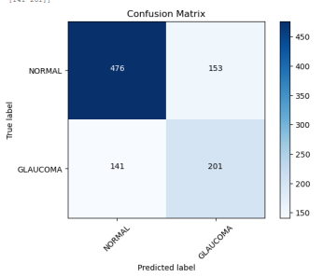
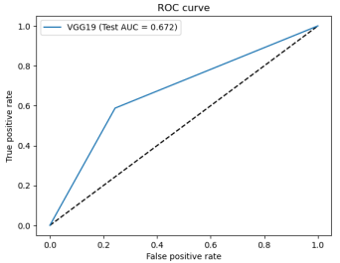
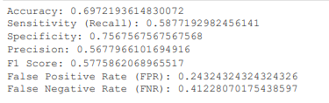
IN TWO OR THREE COLUMNS
VGG19
Yellow
Is the color of gold, butter and ripe lemons. In the spectrum of visible light, yellow is found between green and orange.
Blue
Is the colour of the clear sky and the deep sea. It is located between violet and green on the optical spectrum.
Red
Is the color of blood, and because of this it has historically been associated with sacrifice, danger and courage.

Slide 18
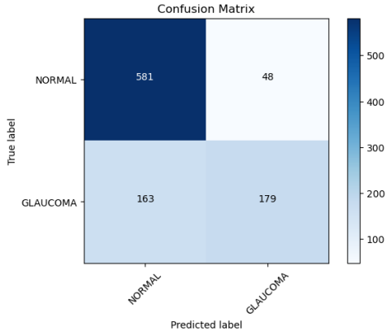
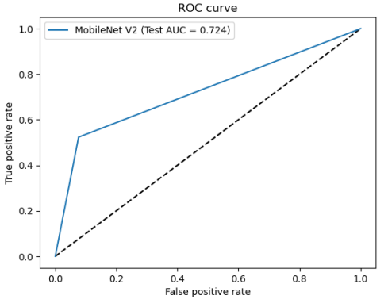
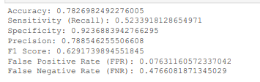
IN TWO OR THREE COLUMNS
MobileNet V2
Yellow
Is the color of gold, butter and ripe lemons. In the spectrum of visible light, yellow is found between green and orange.
Blue
Is the colour of the clear sky and the deep sea. It is located between violet and green on the optical spectrum.
Red
Is the color of blood, and because of this it has historically been associated with sacrifice, danger and courage.

Slide 19
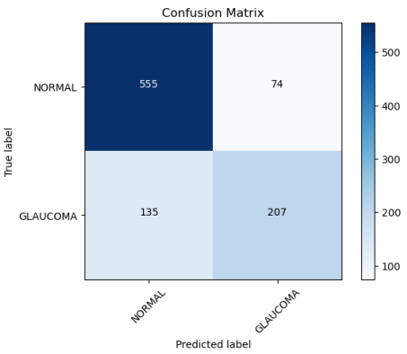
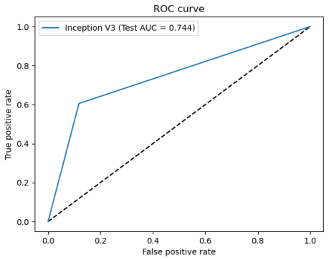
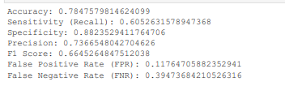
IN TWO OR THREE COLUMNS
InceptionV3
Yellow
Is the color of gold, butter and ripe lemons. In the spectrum of visible light, yellow is found between green and orange.
Blue
Is the colour of the clear sky and the deep sea. It is located between violet and green on the optical spectrum.
Red
Is the color of blood, and because of this it has historically been associated with sacrifice, danger and courage.

Slide 20
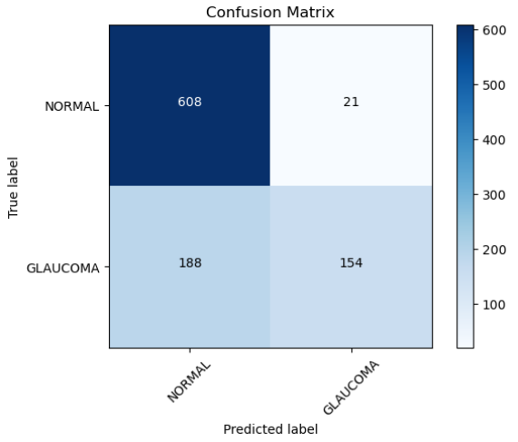
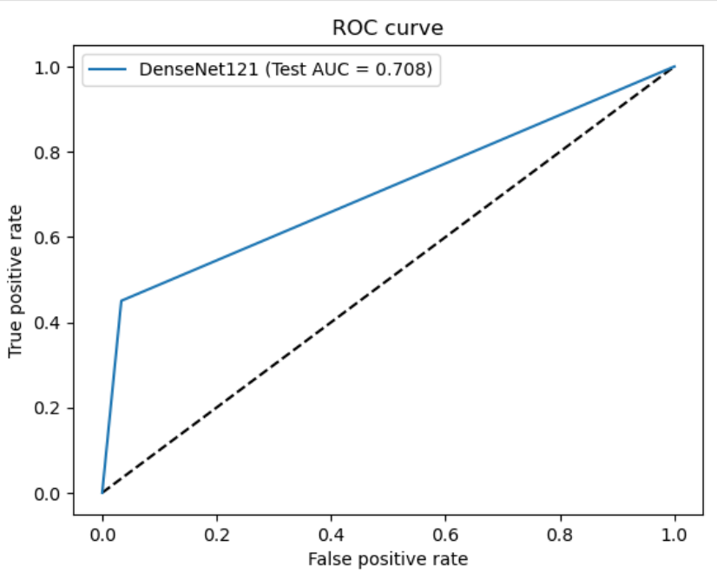
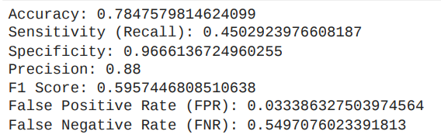
IN TWO OR THREE COLUMNS
DenseNet121
Yellow
Is the color of gold, butter and ripe lemons. In the spectrum of visible light, yellow is found between green and orange.
Blue
Is the colour of the clear sky and the deep sea. It is located between violet and green on the optical spectrum.
Red
Is the color of blood, and because of this it has historically been associated with sacrifice, danger and courage.

Slide 21
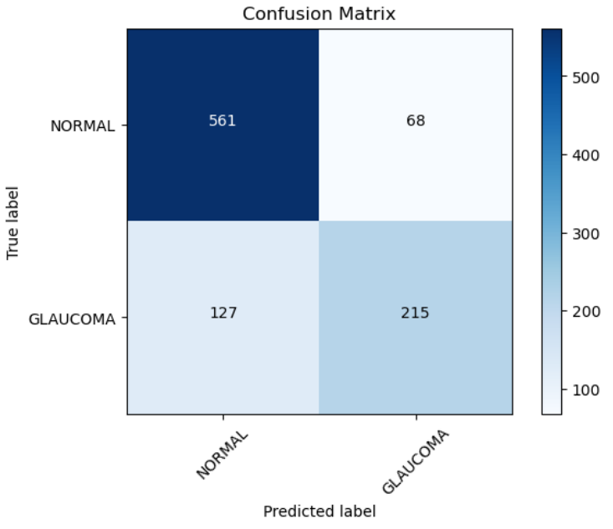
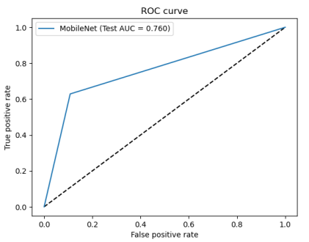
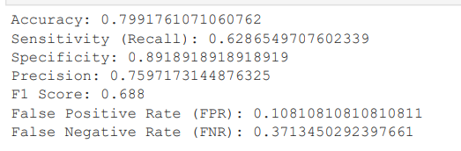
IN TWO OR THREE COLUMNS
MobileNet
Yellow
Is the color of gold, butter and ripe lemons. In the spectrum of visible light, yellow is found between green and orange.
Blue
Is the colour of the clear sky and the deep sea. It is located between violet and green on the optical spectrum.
Red
Is the color of blood, and because of this it has historically been associated with sacrifice, danger and courage.

Slide 22

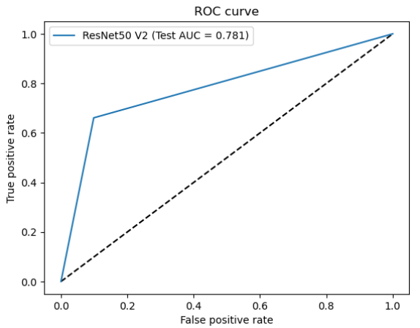
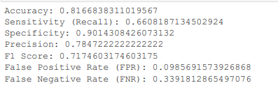
IN TWO OR THREE COLUMNS
ResNet50 V2
Yellow
Is the color of gold, butter and ripe lemons. In the spectrum of visible light, yellow is found between green and orange.
Blue
Is the colour of the clear sky and the deep sea. It is located between violet and green on the optical spectrum.
Red
Is the color of blood, and because of this it has historically been associated with sacrifice, danger and courage.

Slide 23
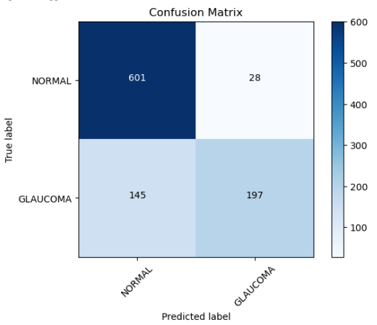
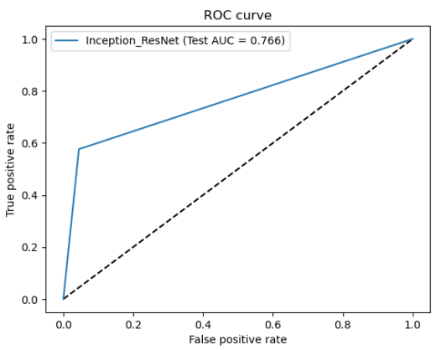
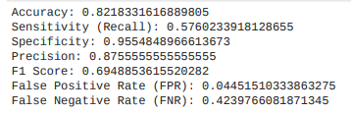
IN TWO OR THREE COLUMNS
Inception_ResNet
Yellow
Is the color of gold, butter and ripe lemons. In the spectrum of visible light, yellow is found between green and orange.
Blue
Is the colour of the clear sky and the deep sea. It is located between violet and green on the optical spectrum.
Red
Is the color of blood, and because of this it has historically been associated with sacrifice, danger and courage.

Slide 24
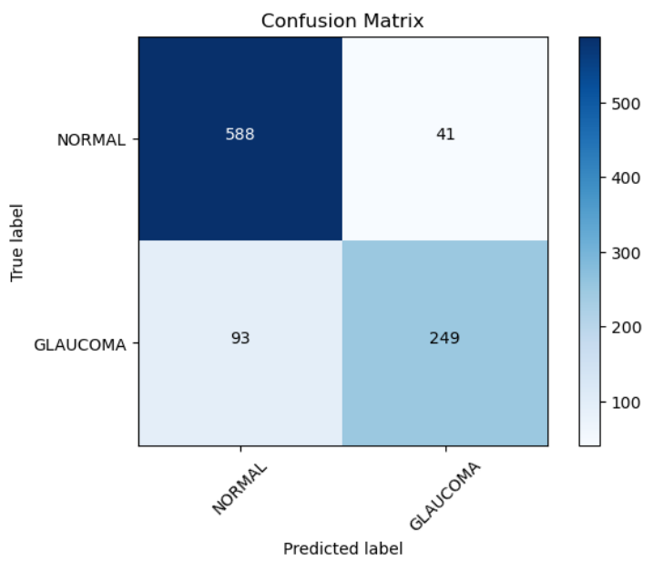
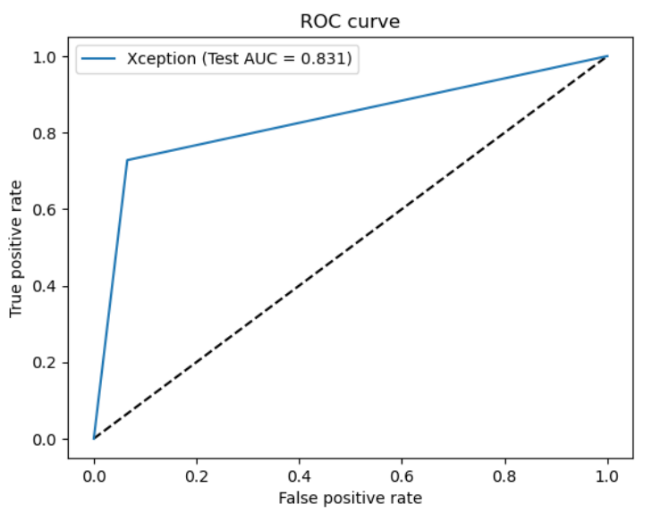
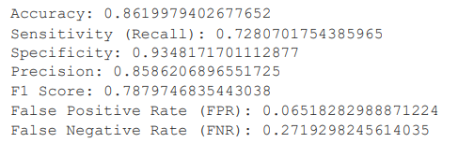
IN TWO OR THREE COLUMNS
Xception
Yellow
Is the color of gold, butter and ripe lemons. In the spectrum of visible light, yellow is found between green and orange.
Blue
Is the colour of the clear sky and the deep sea. It is located between violet and green on the optical spectrum.

Slide 25
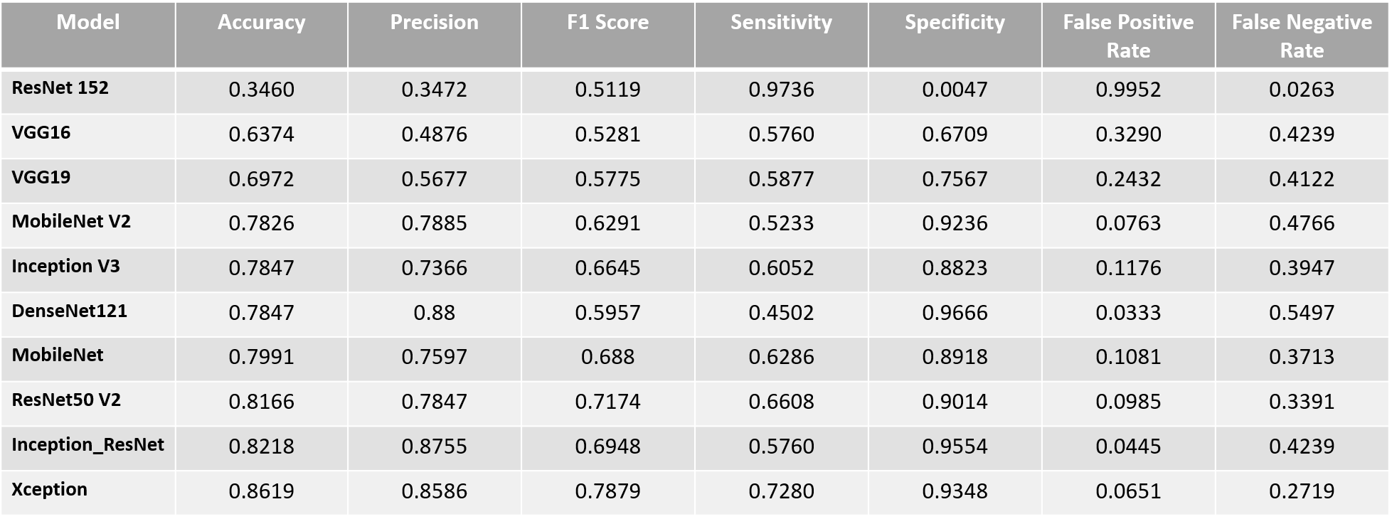
IN TWO OR THREE COLUMNS
Analysis of Glaucoma Detection using various pretrained architecture
Yellow
Is the color of gold, butter and ripe lemons. In the spectrum of visible light, yellow is found between green and orange.
Blue
Is the colour of the clear sky and the deep sea. It is located between violet and green on the optical spectrum.
Red
Is the color of blood, and because of this it has historically been associated with sacrifice, danger and courage.

Slide 26
IN TWO OR THREE COLUMNS
CONCLUSION
Yellow
Is the color of gold, butter and ripe lemons. In the spectrum of visible light, yellow is found between green and orange.
Blue
Is the colour of the clear sky and the deep sea. It is located between violet and green on the optical spectrum.
Red
Is the color of blood, and because of this it has historically been associated with sacrifice, danger and courage.
In recent years, deep learning algorithms have shown promising results in predicting the onset and progression of glaucoma, a leading cause of irreversible blindness. These algorithms have achieved accuracy and sensitivity in detecting early signs of glaucoma, with that the Xception model its high accuracy marks a significant stride towards effective medical imaging solutions.

Slide 27
IN TWO OR THREE COLUMNS
Work Plan
Yellow
Is the color of gold, butter and ripe lemons. In the spectrum of visible light, yellow is found between green and orange.
Blue
Is the colour of the clear sky and the deep sea. It is located between violet and green on the optical spectrum.
Red
Is the color of blood, and because of this it has historically been associated with sacrifice, danger and courage.
Fine Tuning Xception model
Developing a CNN architecture for Glaucoma detection
Semantic segmentation

Slide 28
IN TWO OR THREE COLUMNS
REFERENCE
[1] Juneja, Mamta, et al. "Deep learning-based classification network for glaucoma in retinal images." Computers and Electrical Engineering 101 (2022): 108009.
[2] Sonti, Kamesh, and Ravindra Dhuli. "A new convolution neural network model “KR-NET” for retinal fundus glaucoma classification." Optik 283 (2023): 170861.
[3] Kausu, T. R., et al. "Combination of clinical and multiresolution features for glaucoma detection and its classification using fundus images." Biocybernetics and Biomedical Engineering 38.2 (2018): 329-341.
[4] Kishore, Balasubramanian, and N. P. Ananthamoorthy. "Glaucoma classification based on intra-class and extra-class discriminative correlation and consensus ensemble classifier." Genomics 112.5 (2020): 3089-3096.
[5] Fang, Lingling, and Huan Qiao. "Glaucoma multi-classification using the novel syndrome mechanism-based dual-channel network." Biomedical Signal Processing and Control 86 (2023): 105143.
Yellow
Is the color of gold, butter and ripe lemons. In the spectrum of visible light, yellow is found between green and orange.
Blue
Is the colour of the clear sky and the deep sea. It is located between violet and green on the optical spectrum.
Red
Is the color of blood, and because of this it has historically been associated with sacrifice, danger and courage.

Slide 29
IN TWO OR THREE COLUMNS
REFERENCE
Yellow
Is the color of gold, butter and ripe lemons. In the spectrum of visible light, yellow is found between green and orange.
Blue
Is the colour of the clear sky and the deep sea. It is located between violet and green on the optical spectrum.
Red
Is the color of blood, and because of this it has historically been associated with sacrifice, danger and courage.
[6] Nawaldgi, Sharanagouda, and Y. S. Lalitha. "Automated glaucoma assessment from color fundus images using structural and texture features." Biomedical Signal Processing and Control 77 (2022): 103875.
[7] Singh, Law Kumar, et al. "Efficient feature selection based novel clinical decision support system for glaucoma prediction from retinal fundus images." Medical Engineering & Physics 123 (2024): 104077.
[8] Jun, Tae Joon, et al. "TRk-CNN: transferable ranking-CNN for image classification of glaucoma, glaucoma suspect, and normal eyes." Expert Systems with Applications 182 (2021): 115211.
[9] Balasubramanian, Kishore, K. Ramya, and K. Gayathri Devi. "Improved swarm optimization of deep features for glaucoma classification using SEGSO and VGGNet." Biomedical Signal Processing and Control 77 (2022): 103845.

Slide 30
THANK YOU !

